Slide 1
Weather Classification using Images
Presented by:
Sowmya Cheedu – scheedu@iu.edu
Bhargavi thanneeru – bthannee@iu.edu
Ayesha Tajammul Ahmed Mulla– amulla@iu.edu

Slide 2
Contents
Abstract
Problem Statement
Implementation Workflow
Data Preprocessing
Data Analysis
Data Augmentation
ML Model Implementation
Results
Applications
Conclusion
References

Slide 3
Abstract:
Weather phenomena have a significant impact on many elements of our everyday life, but only a few studies attempt to categorize actual photographs of weather phenomena, due to time consumption and error-prone nature it takes a lot of time and is prone to error to distinguish between different weather occurrences using the usual artificial visual method.
In this study, the classification of meteorological phenomena is proposed using a revolutionary deep convolutional neural network (CNN) called ResNet. Meanwhile, we create a data set called the weather classification, which has 12373 images divided into 11 classes. On the dataset, the ResNet model's classification accuracy is approximately 93%. For the comparison, three more models, VGG16, Xception and CNN are developed in addition to the ResNet model.
Understanding the automatic and accurate classification of images of weather occurrences can serve as a guide for upcoming studies on weather image classification and weather forecasting.

Slide 4
Problem Statement
Weather phenomenon recognition notably affects many aspects of our daily lives, for example, weather forecast, road condition monitoring, transportation, agriculture, forestry management, and the detection of the natural environment. To the best of our knowledge, the traditional artificial visual distinction between weather phenomena takes a lot of time and is prone to errors. Hence, using the real time images would give more accurate results.
We are using the dataset of images with 11 classes namely rain, rime, hail, snow, sandstorm, fogsmog, rainbow, dew, glaze, lightning, frost.
Weather Classification model using real time images

Slide 5
Implementation Workflow
Data Preprocessing
Data Analysis
Data Augmentation
ML model Implementation
Evaluating ML model performance

Slide 6
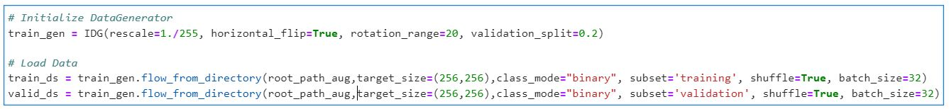
Data Preprocessing
This dataset contains 6862 images of different types of weather which are used to implement weather classification based on the photo.
The data is divided into 11 classes indicating different weathers such as snow, rain, frost, rime, lightning, sandstorm, etc.
The images used for training the Machine Learning model have uniform dimensions of 256x256 pixels and are divided in a ratio of 80:20 for training and testing respectively
The augmentations applied on the data while loading them were horizontal flips and rotations by an angle of 20°

Slide 7
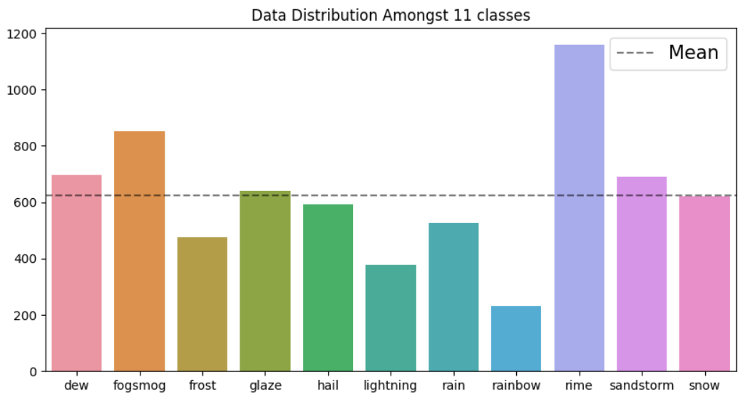
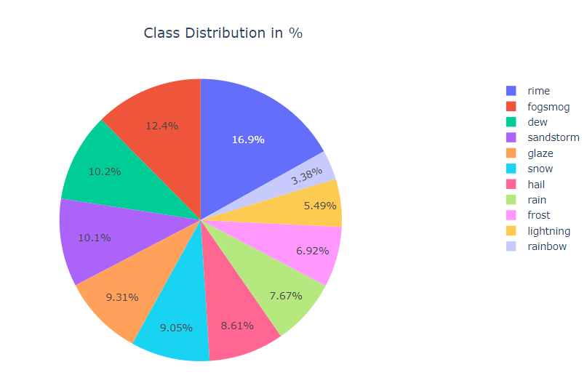
Exploratory Data Analysis
Plot for Data Distribution between the classes before Augmentation

Slide 8
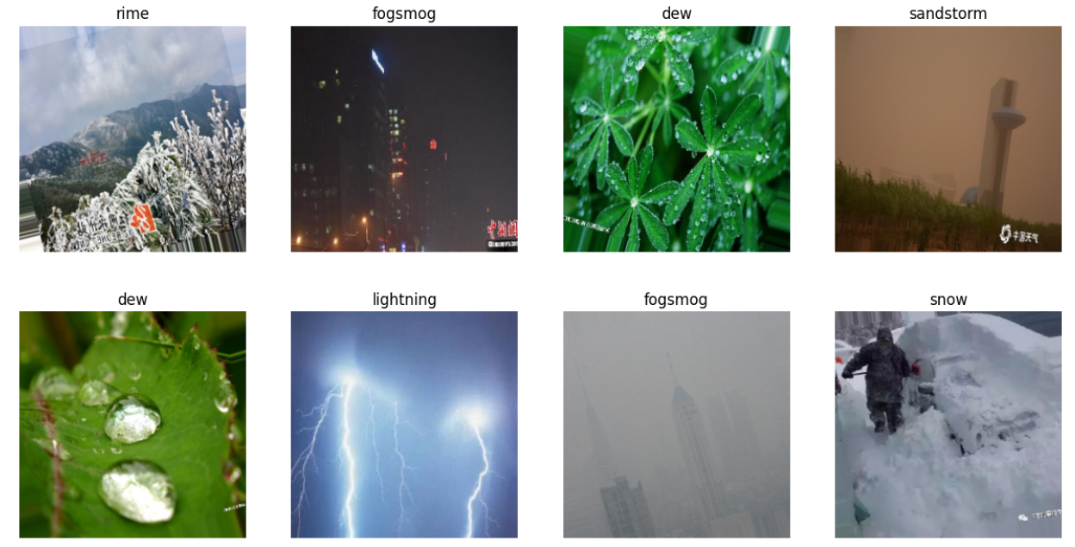
Snippets of the Data before Augmentation

Slide 9
Data Augmentation
In this phase our goal was to increase the dataset size and create balanced distribution of data between different classes and avoid any biases
The extended goal of this phase is to increase the accuracy of the neural network model by increasing the size of the data and adding variations in the dataset.
We achieved this by applying random rotation and horizontal flip on the images.
The final size of the dataset increase from 6862 images to 12373 images which is approximately double its size

Slide 10
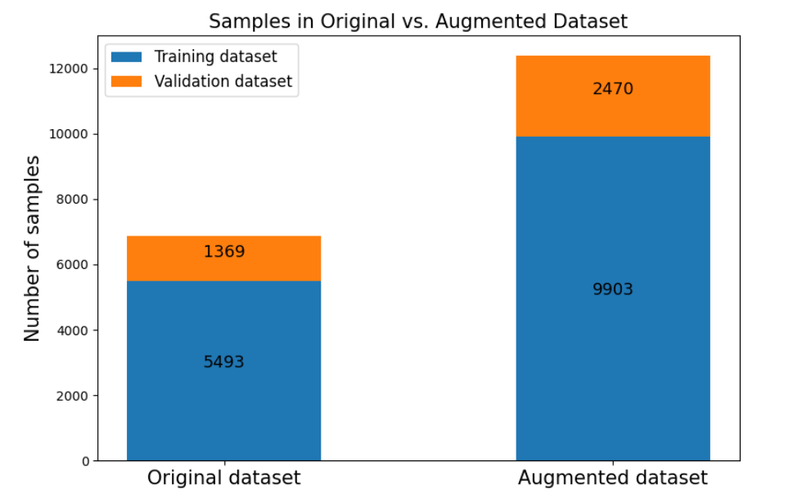
Comparison between Data Distribution for Training and Validation set before and after Augmentation

Slide 11
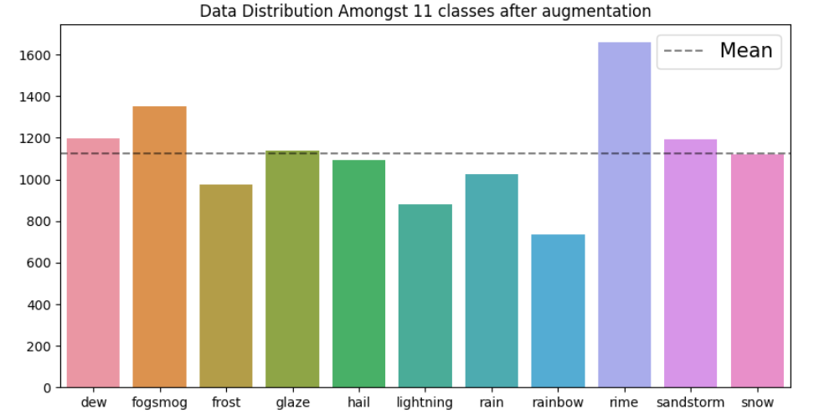
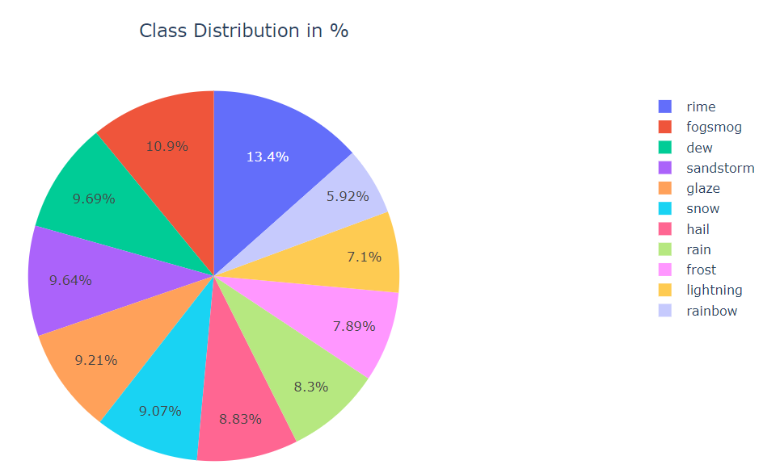
Plot for Data Distribution between the classes after Augmentation ​

Slide 12
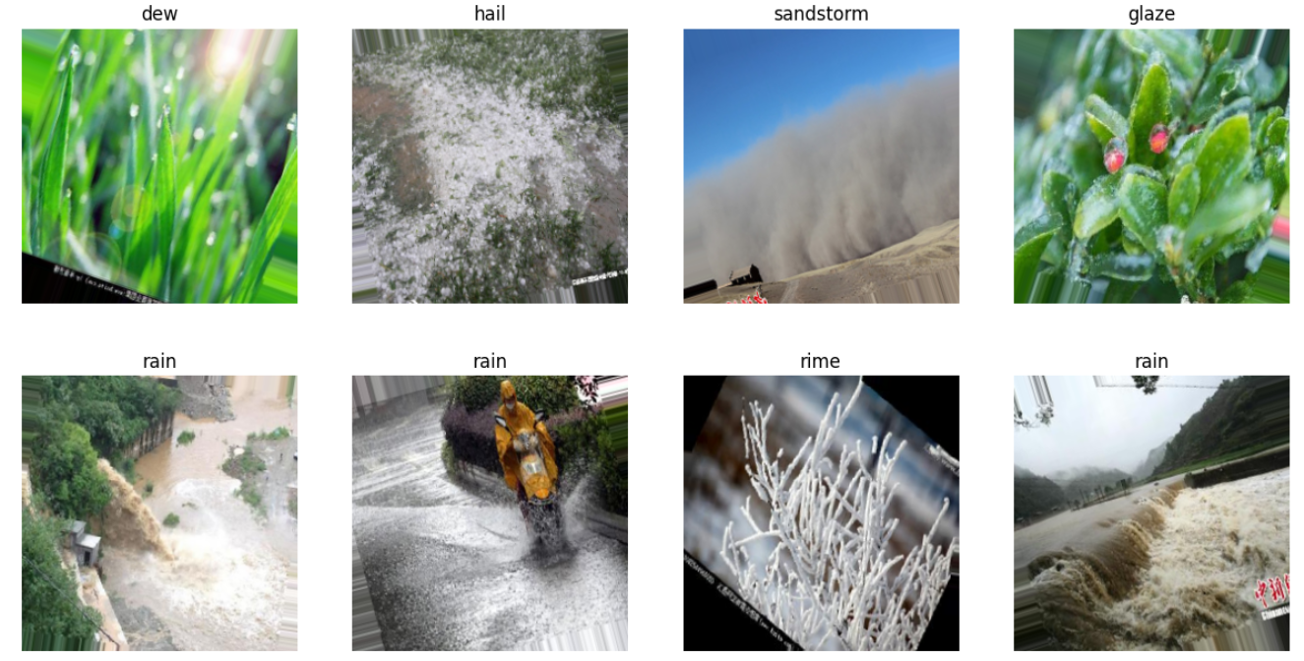
Snippets of the Data after Augmentation​

Slide 13
ML Model Implementation
In this phase we implemented 4 different Neural Network models for Image Classification:
a. Convolutional Neural Networks (CNN)
b. Resnet152V2
c. VGG16
d. Xception

Slide 14


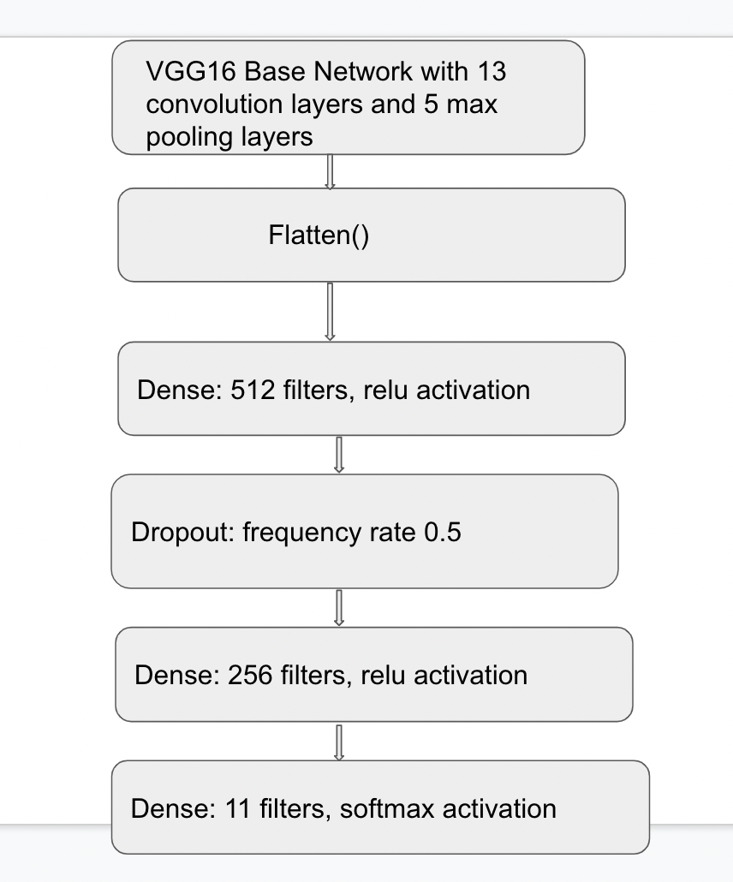
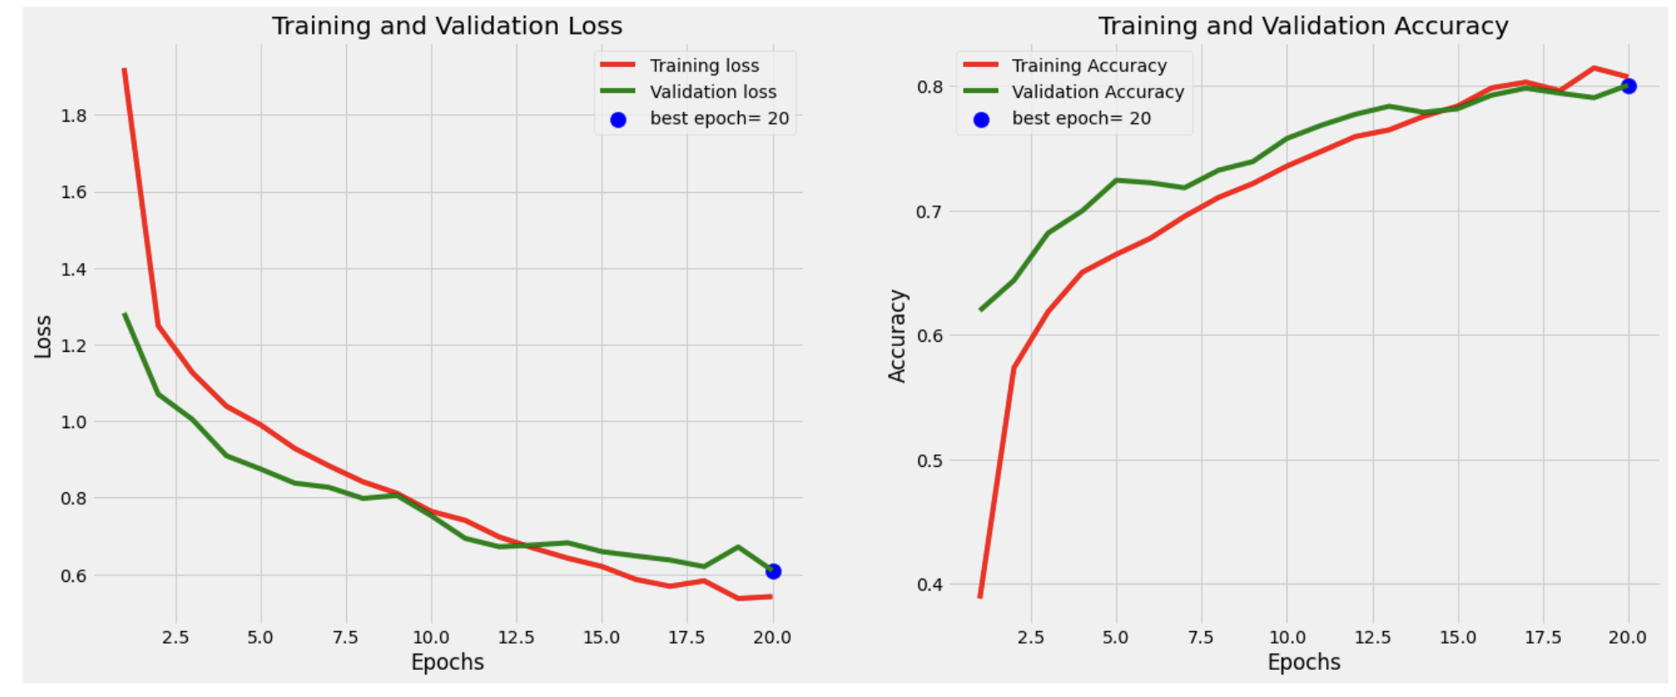
Convolutional Neural Networks (CNN)
Model Architecture
Accuracy and Loss History

Slide 15
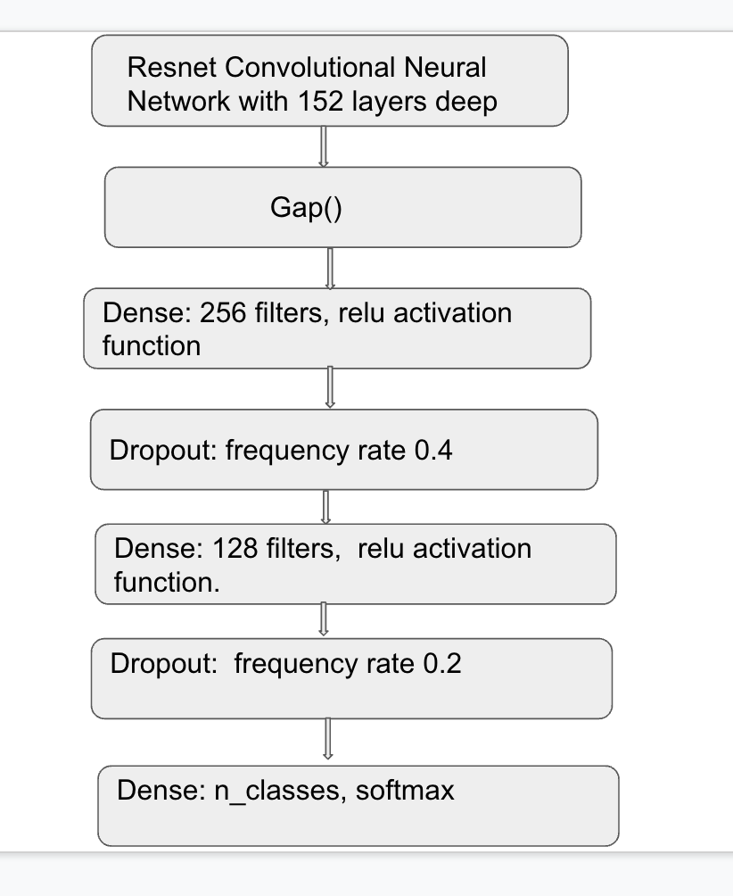
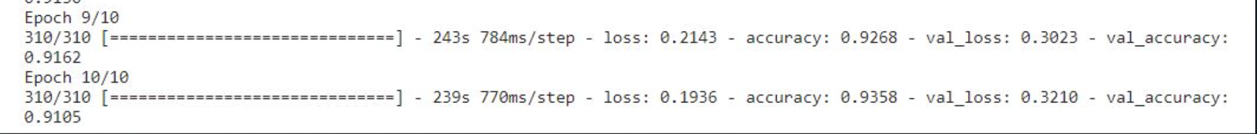
Resnet
Model Architecture
Accuracy and Loss History

Slide 16
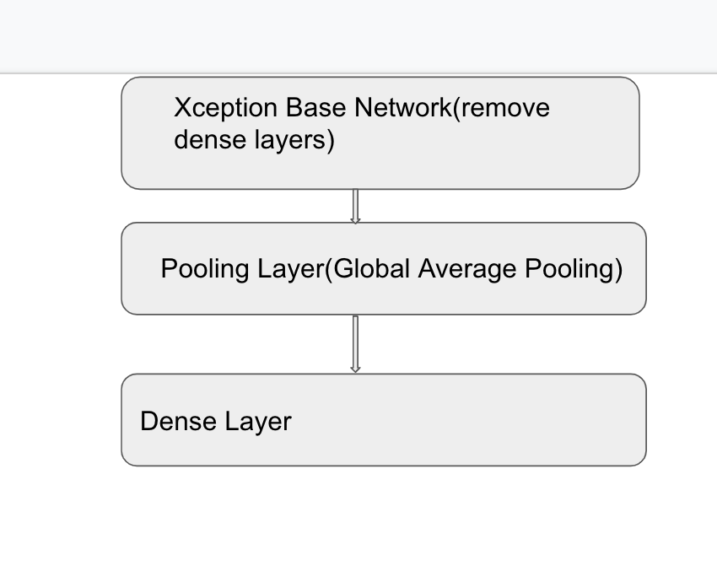
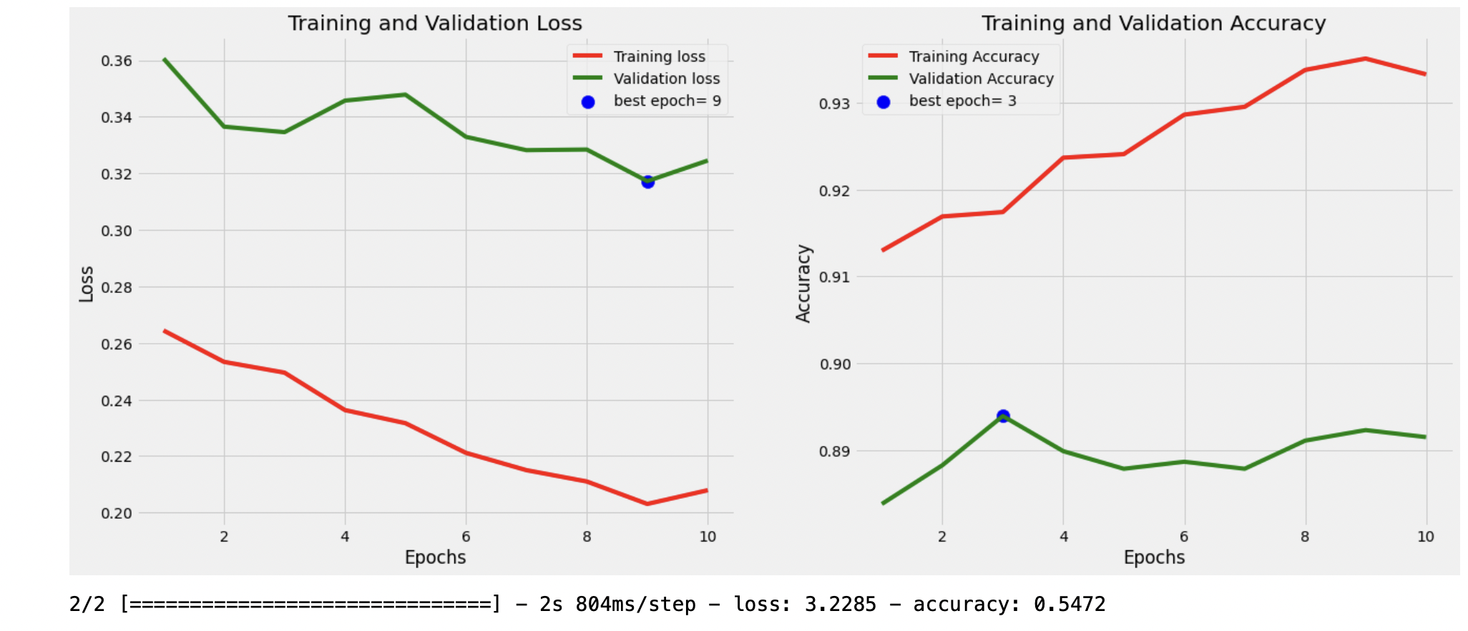
Xception Model
Model Architecture
Accuracy and Loss History

Slide 17
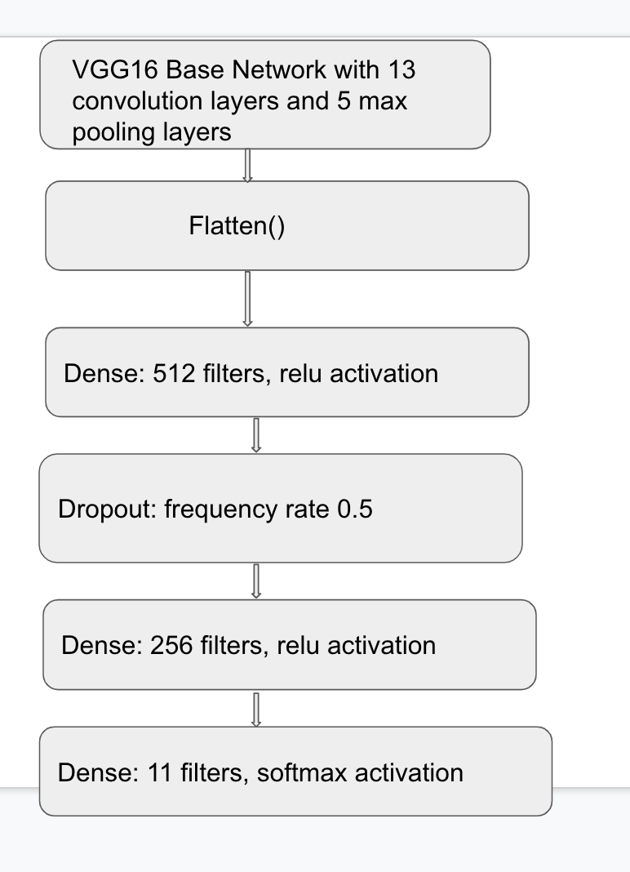
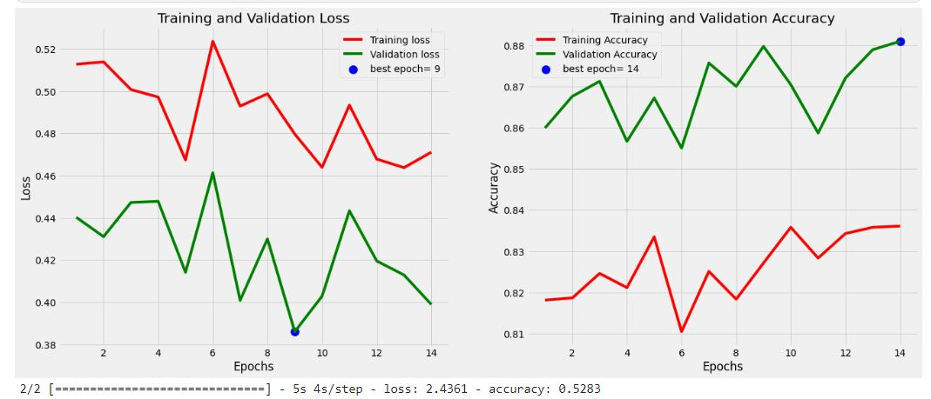
VGG-16 Model
Model Architecture
Accuracy and Loss History

Slide 18
ML model Results

Slide 19
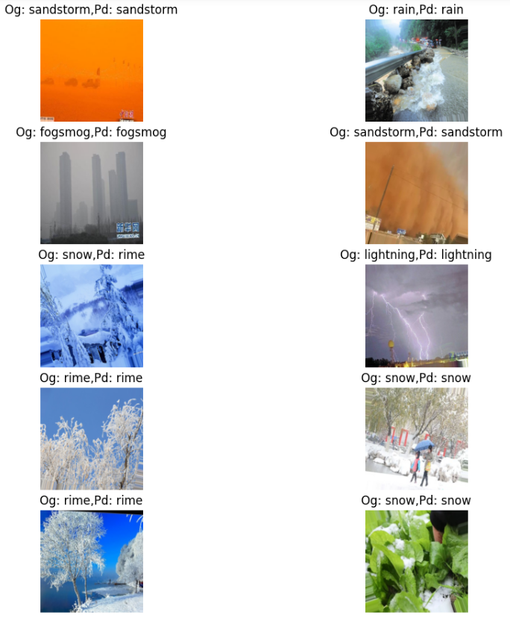
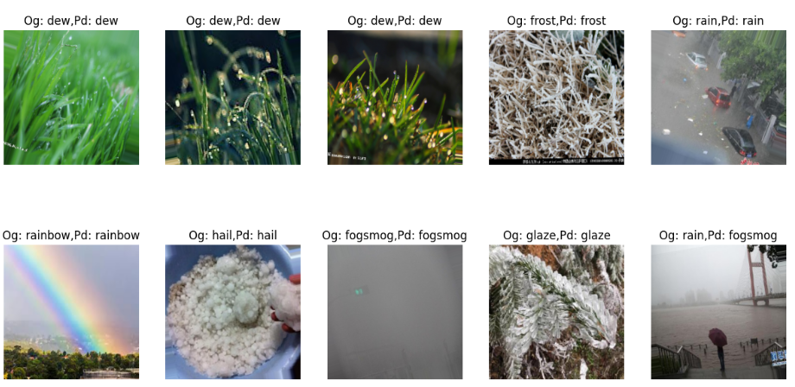
CNN

Slide 20
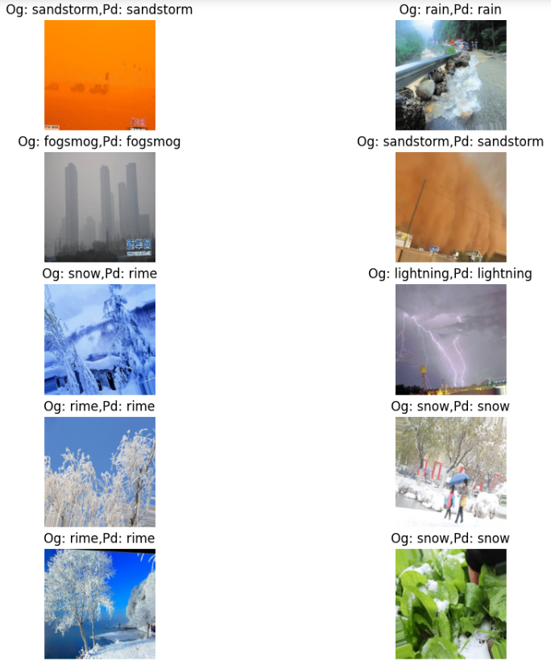
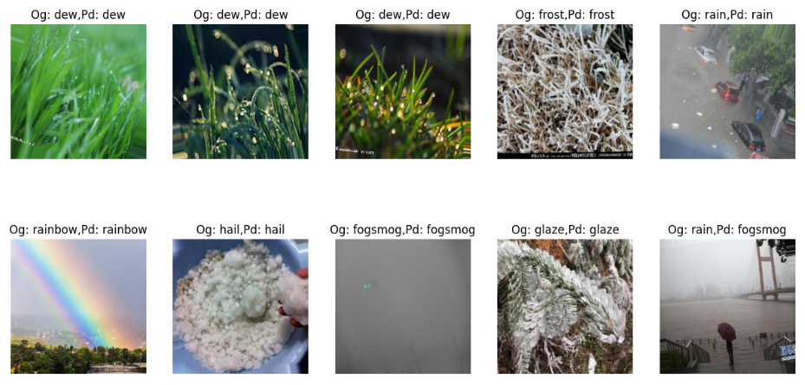
Xception

Slide 21
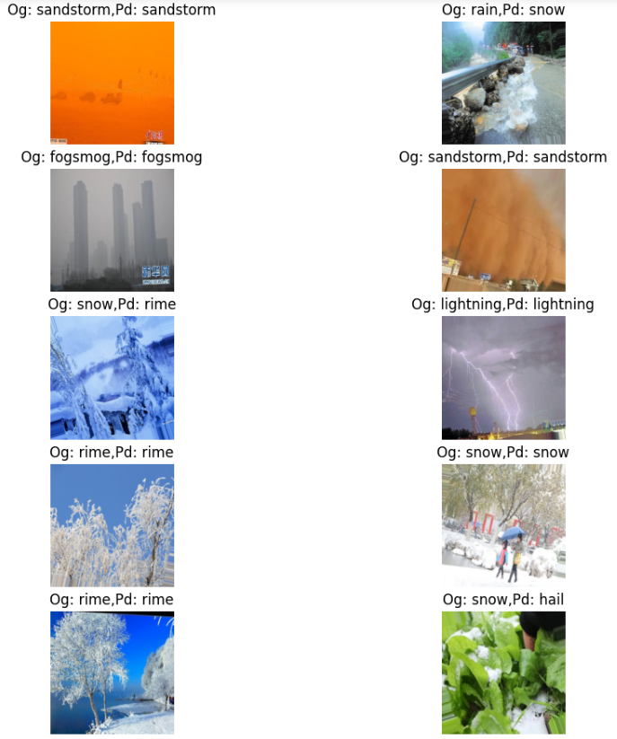
Resnet

Slide 22
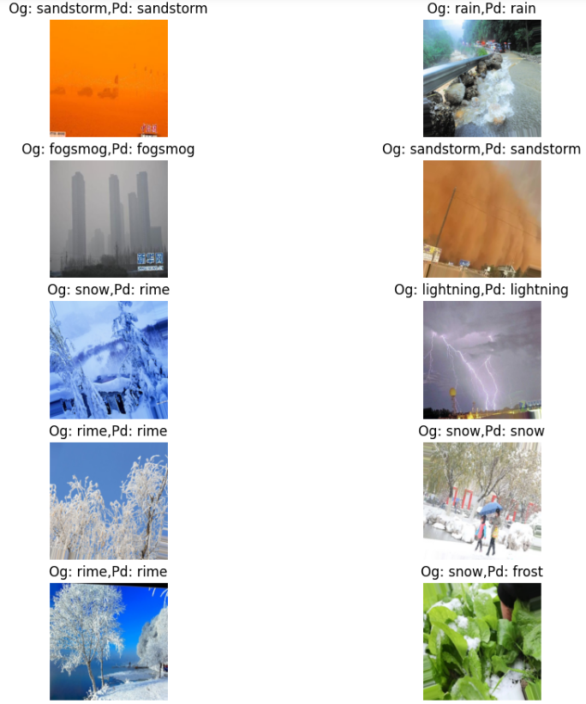
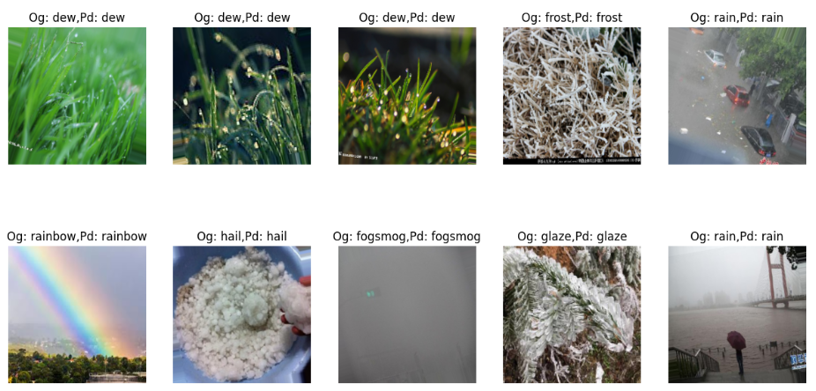
VGG16

Slide 23
Model Comparisons
On comparing the performances of the 4 different model architectures we can infer the following:
1. Resnet152v2 model has a large and deeper architecture with 58 million parameters
2. VGG16 has a comparatively smaller architecture with 31 million parameters but the performance is at par with Resnet152v2
3. A CNN model implemented has the smallest architecture with 7 million parameters and the lowest accuracy compared to the other model performances
4. The highest accuracy achieved was 93.6% using the Resnet152v2 model

Slide 24
Applications:
Weather type classification systems can be used in detailed studies of weather conditions, and also as basic information on climate variations during any period (month, season or year)
Furthermore, weather phenomena not only strongly influences vehicle assistant driving systems but also affects us in our daily lives, such as the wearing, traveling, and solar technologies
The functionality of many visual systems like outdoor video surveillance is also affected by weather phenomena
It can be used to predict the weather in the next few days by considering the today’s pictures of the climate.
Additionally, the weather phenomena (haze, snow, sandstorm, and so on) that occurred the day before will also affect weather conditions for the next few days.

Slide 25
Conclusion
We have experimented and successfully built a Weather Classification model using Machine learning algorithms such as CNN model, ResNet Model, Xception Model and VGG16 Model.
Based on performance metrics used we can infer that VGG16 and Resnet152 perform better for Image Classification.

Slide 26
References:
https://link.springer.com/article/10.1007/s00704-020-03118-2#:~:text=Weather%20type%20classification%20systems%20can,year%20or%20long%2Dterm
https://agupubs.onlinelibrary.wiley.com/doi/full/10.1029/2020EA001604
https://www.ncbi.nlm.nih.gov/pmc/articles/PMC5504082/
https://towardsdatascience.com/step-by-step-vgg16-implementation-in-keras-for-beginners-a833c686ae6c
https://www.hindawi.com/journals/amete/2020/6972826/

Slide 27
Thank You..

